Slide 1
PREPRODUCTION

Slide 2
PREPRODUCTION IN AUDIOVISUAL
The idea
The type of story
Where will it be published
Tone
Target
The people involved in the production
Technical equipment
We always need to prep before going on the field to gather stories. This stage is called preproduction.
This is the very first process you must do when you plan your video or story. In this stage you can determine:

Slide 3
Prepare ahead of your mission
It’s very unlikely to have the time we would need to gather all the quality content when we’re on the field. It’s our reality. So, to set you up for success, it is essential to plan ahead. Here we have a few recommendations:
Talk with your colleagues at the branch
Ask for specific information
Prepare your gear
Line-up your interviews

Slide 4
SCRIPT
Technical script: this one is specific for the people shooting the video, So they can know where to position each element in every take.
Discussion:
Why do we need a script?

Slide 5
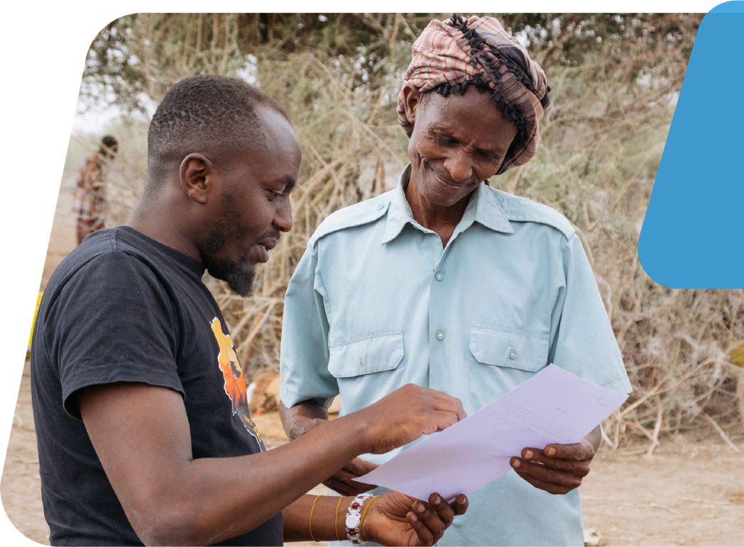
Quick things to remember when making a script in today’s media world.
The catchy intro
How will you keep their attention
Include as much visual details as possible

