Slide 1
PRODUCTION

Slide 2
PRODUCTION: PHOTO AND VIDEO PRINCIPLES
You will capture the footage using your mobile phone or a camera, and ideally microphone/ or lights. This is for both shooting on a certain location – like a community – or in a studio.
Camera concepts

Slide 3
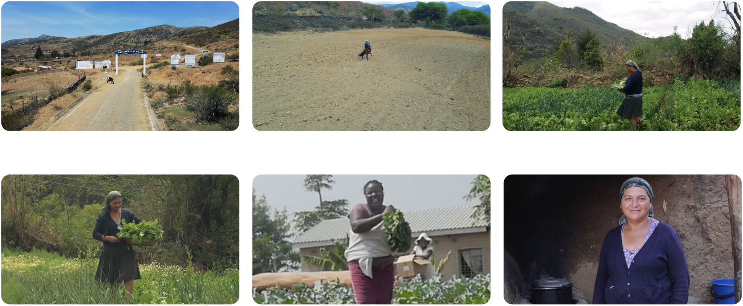
TYPES OF SHOTS
Establishing shot
Extreme wide shot
Wide shot
Full shot
Medium long shot
Medium shot

Slide 4
TYPES OF SHOTS
Medium close up
Close up
Extreme close up

Slide 5
TYPES OF SHOTS BY FRAMING SUBJECTS
Single shot
Two shot
Three shot
Over the shoulder
Point of view
Over the hip

Slide 6
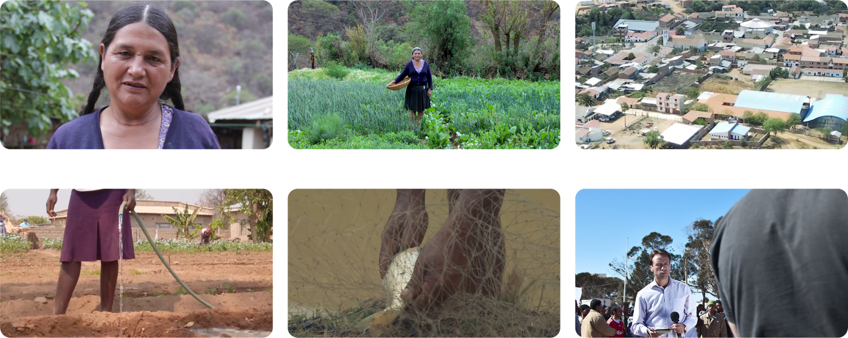
ANGLES
Eye level shot
Low angle shot
Hight angle shot
Knee level shot
Ground level shot
Shoulder level shot

Slide 7
ANGLES
Bird´s eye view shot
Aerial shot

Slide 8
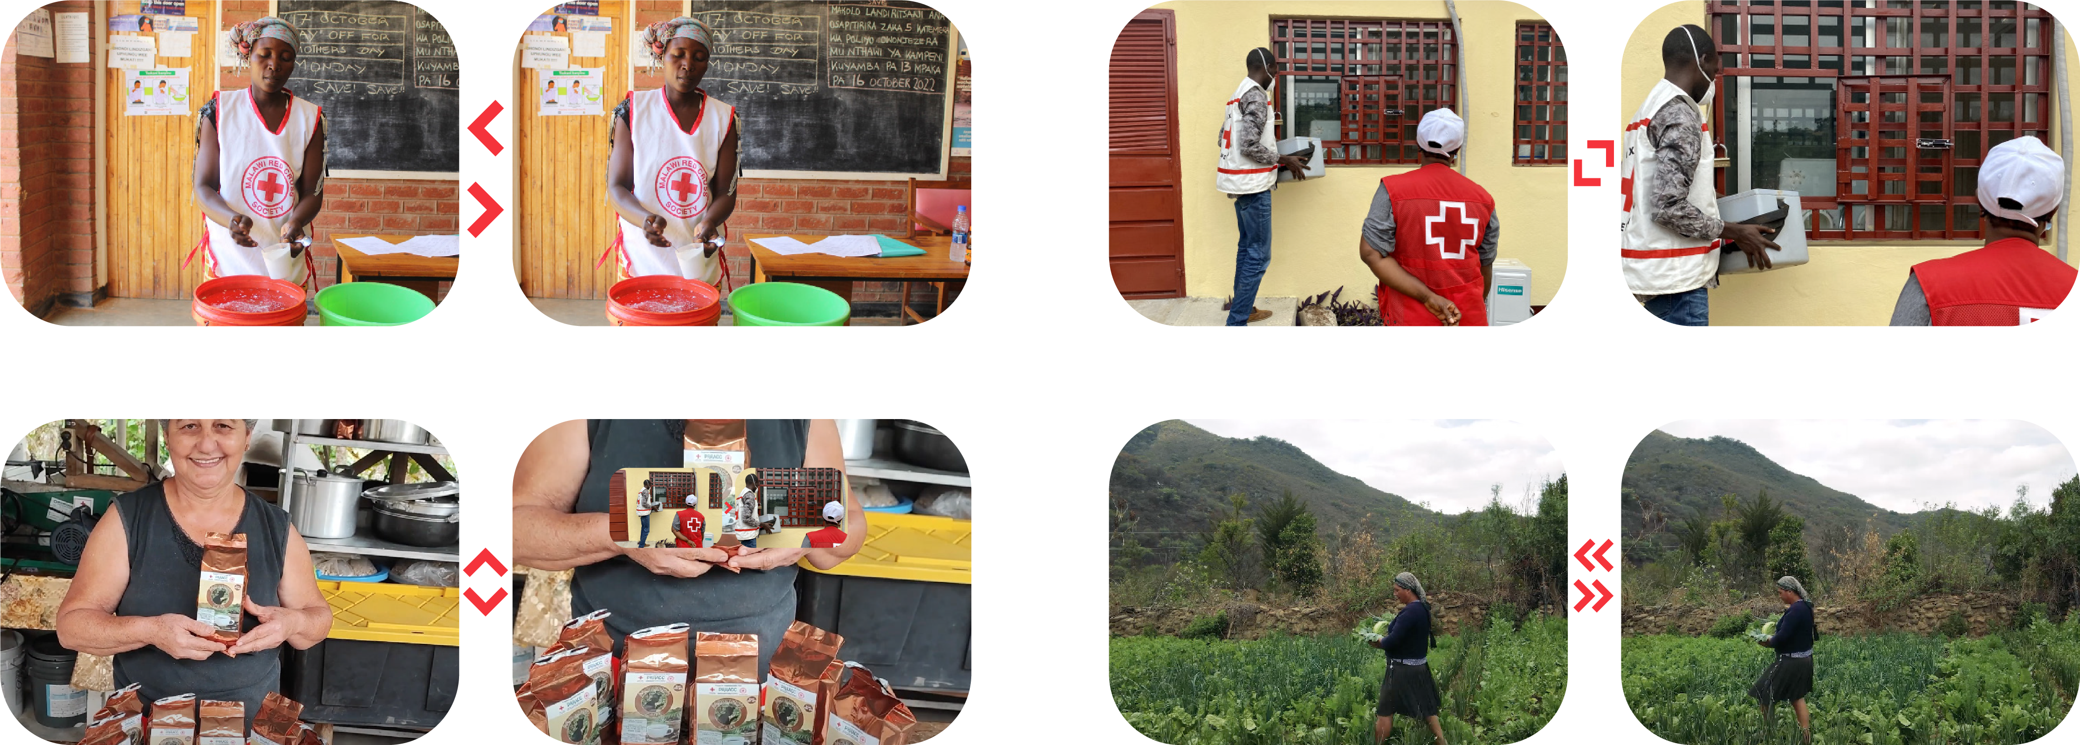
MOVEMENTS
Pan
Zoom
Pan
Tracking shot

Slide 9
MOVEMENTS
Dolly shot
Pedestal
Following / traveling shot

Slide 10
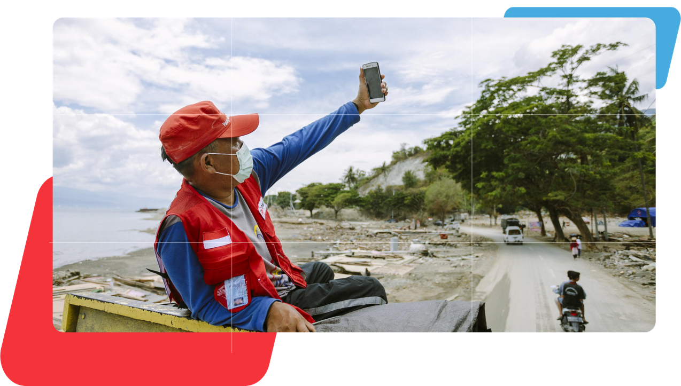
RULE OF THIRDS

Slide 11
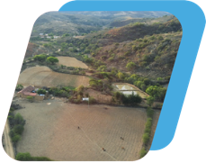
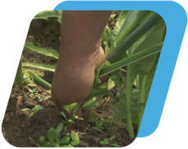
Here are some tips
Start with a wide or establishing shot
Then, introduce the main character.
Combine details and more close up shots to tell the story.
For social media content, it’s recommended to start with a catchy shot, quote or action from the character.

Slide 12
Photo tips
Use your focus wisely, always tap your screen to ensure the right place or person is focused.
Always try to use proper light, the camera not always catches what we see, so it’s important to take the photos with proper light.
Hold your phone still so your photos do not appear blurry or warped.
Consider getting a tripod so you can always know that your photo is well balanced.
Look for symmetry or asymmetry in your photos, this will give order and balance to your photo.
Search for patterns, if you see elements that repeat over and over, like lines, geometric shapes, forms and colours, they will make a strong visual impact.
Do not to use zoom. This will reduce the quality of the image, , blur or put grain in your photo.
Always maintain your camera lens clean. Clean it with a soft cloth.

Slide 13
LET´S PRACTICE!
Practice the type of shots, angles and movements and share with colleagues and mentors for feedback.

Slide 14
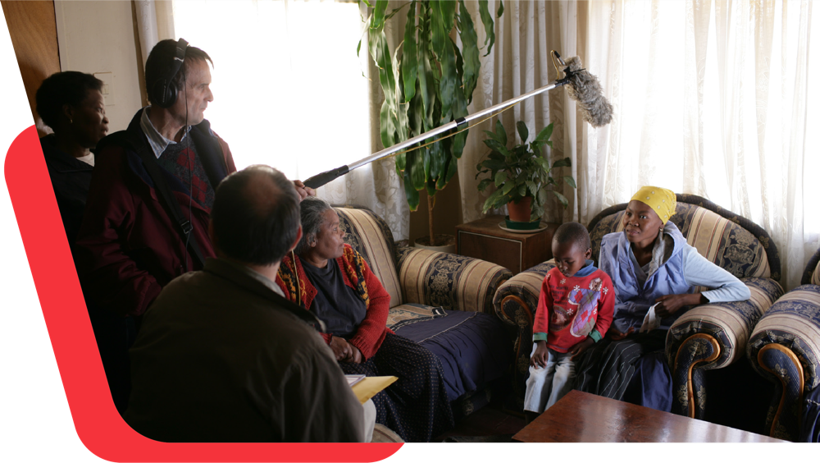
CAPTURING GREAT AUDIO
Basic concepts:
The closer the better. The single most important factor when recording sound is that the microphone is close to the source of the sound
Think about the environment. It is generally better to do interviews in environments that are as quiet as possible.

Slide 15
TOOLS TO USE
Voice record pro

Slide 16
TO RECORD AUDIO ANV VIDEO SIMULTANEOUSLY
The best option to record audio is to do it directly while shooting your video. But you would have to be very close to the audio source or have an external microphone connected to your phone. There are several types of external microphones but these are the ones you’ll need most:
Lapel mics
Earphone mic
If youdon´t have an external microphone stay close

Slide 17
TIPS TO IMPROVE YOUR AUDIO
If you do not have a microphone, but have two phones, you can use one to take video and the other one to record audio and put it as close as possible to the character’s mouth. This is one of the best and easiest solutions as the audio recorded on the extra phone can easily be synched up to the video recording later.
Always make a sound test before you take the actual footage. Record the person stating their name and job title, and you can also ask them to count from 1 to 10.
If there is a lot of background noise, ask if it can be turned down, if not, search other location for better audio results.
If possible, always listen to the interview in real time so you can hear what is actually being recorded.

Slide 18
LIGHTNING PRINCIPLES
Make sure the light is shining on or at the thing you want to film, not at your camera. So, when you are in the field, position yourself behind the sun and shining on the thing or person you are shooting.
Think about the environment. Will you be in the shade, under trees? What are the natural and unnatural sources of light, reflection and shade. Use these to your advantage.
Don’t be afraid to ask for help. Some good lighting fixes are simple, but it can require an extra set of hands.
If you’re worried that your subject will get impatient, or not understand why you are doing this, use these concepts to explain why this will make a big difference in making them look much better in the video or photo.

Slide 19
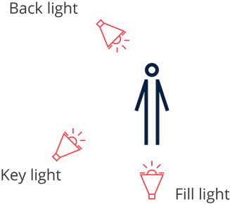
TYPES OF LIGHT
Natural: This comes from the sun and is affected by the time of day. Some good times to shoot with natural light are mid-morning and mid-afternoon, so there is enough light, but not so much it burns your take.
Artificial: This light comes from lamps, spots, flashes and other luminous objects that can be controlled by you.
In an ideal world you would have 3 lights to do a standard three-point lighting like this one:
Sometimes this is difficult to do, and sometimes there is no time to set the lights in the rush of the situation. If you have one light, it could be a light from a phone, or if you have a ring light you can use a different lighting scheme like the one in the next slide.

Slide 20
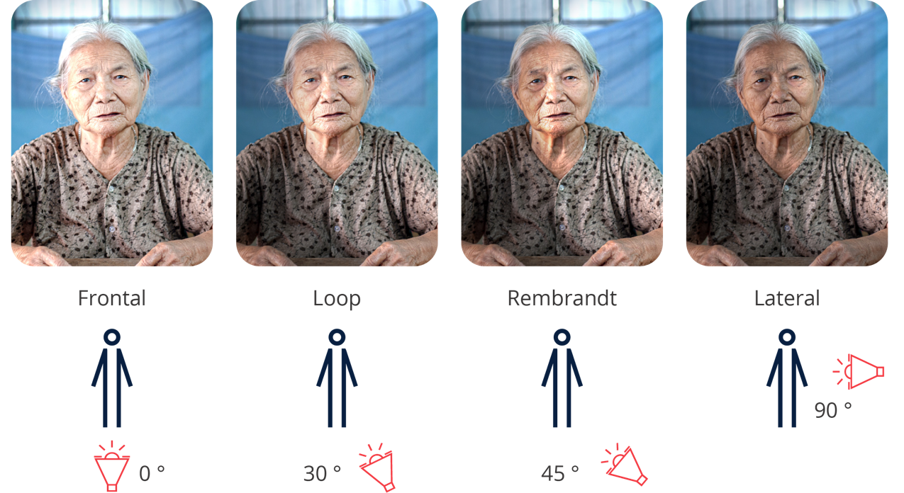
If you don’t have any other lights, you can also use the one on your phone while you take the footage. That will give you a frontal light, but just be sure not to be very close to the person so it doesn’tburn your take.

